Slide 1


Slide 2
Objectives
Christians United for Israel (CUFI) is passionate about defending Israel and the Jewish people along with the Judeo-Christian values of our nation.
Confront antisemitism in the UK and Europe.
Shape public opinion and government policy through our campaigns.
Defend Britain’s Judeo-Christian heritage.
Stand with the Jewish community in the UK.
Bless the nation of Israel through charitable projects.

Slide 3

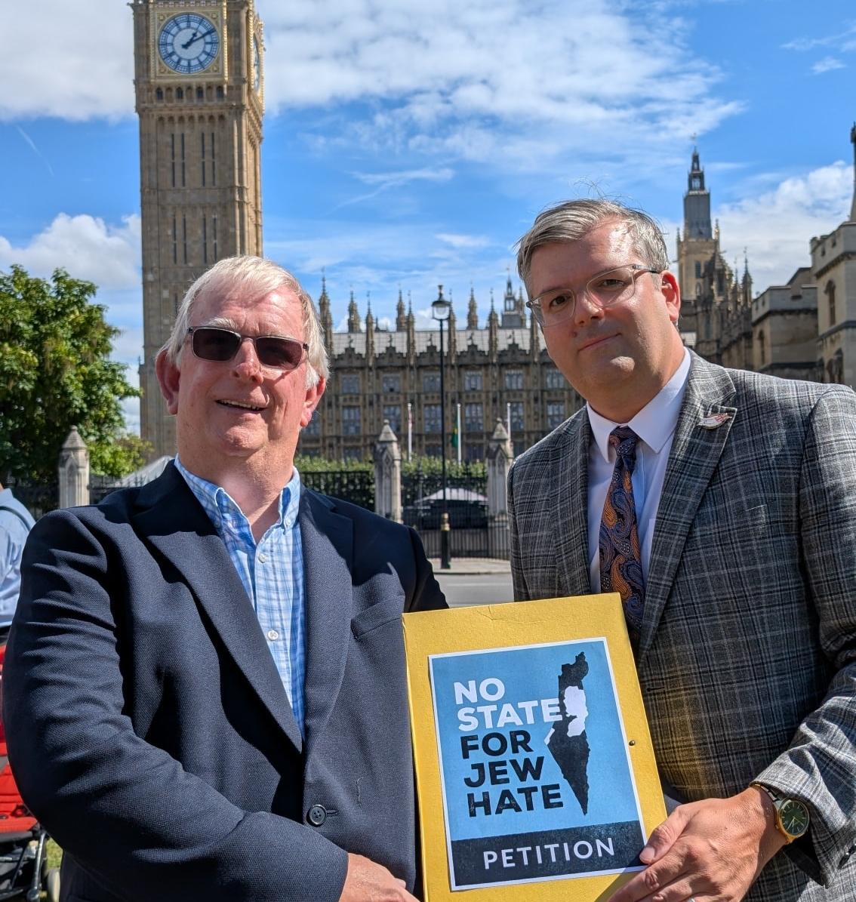
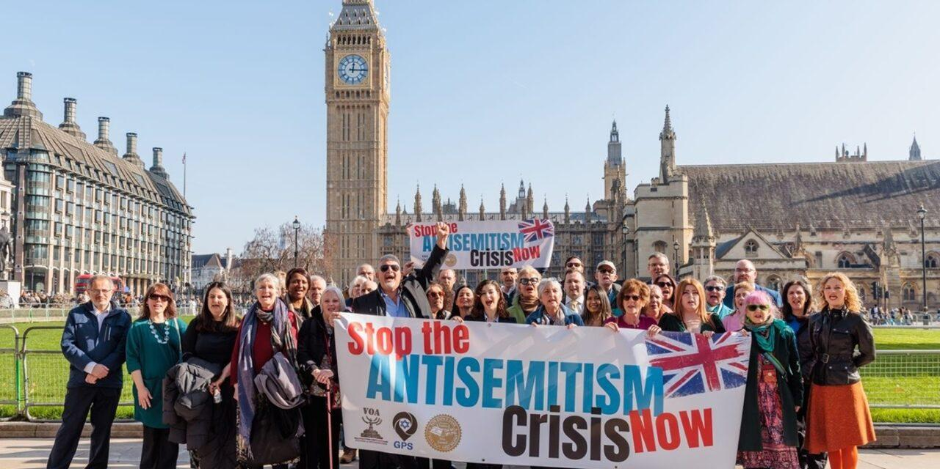

Slide 4
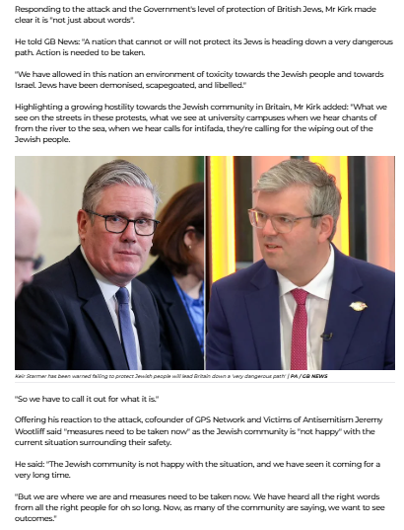


Slide 5


Slide 6

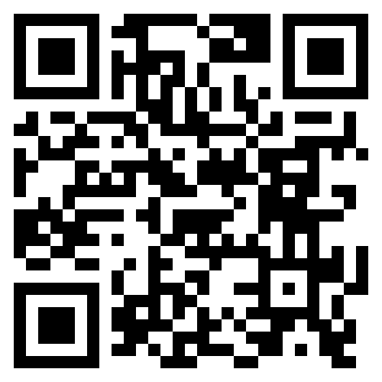


Free Torch Magazine www.cufi.org.uk/torch

Slide 7



Join CUFI as we sit down to discuss current issues affecting Israel.
www.cufi.org.uk/podcast

Slide 8
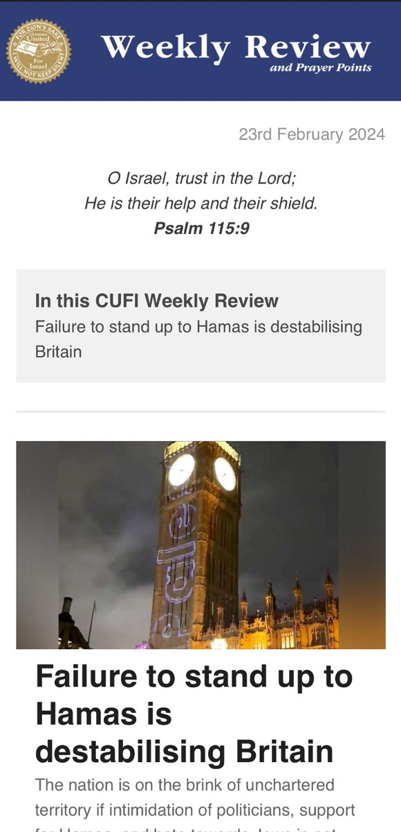
Sign-up to receive emails
Receive:
Weekly Review
Campaigns
Podcast
Other updates

Slide 9
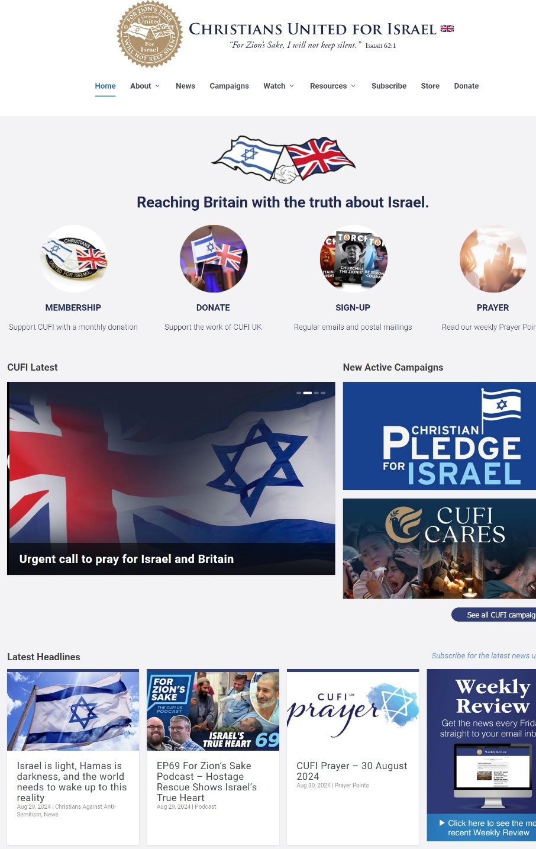
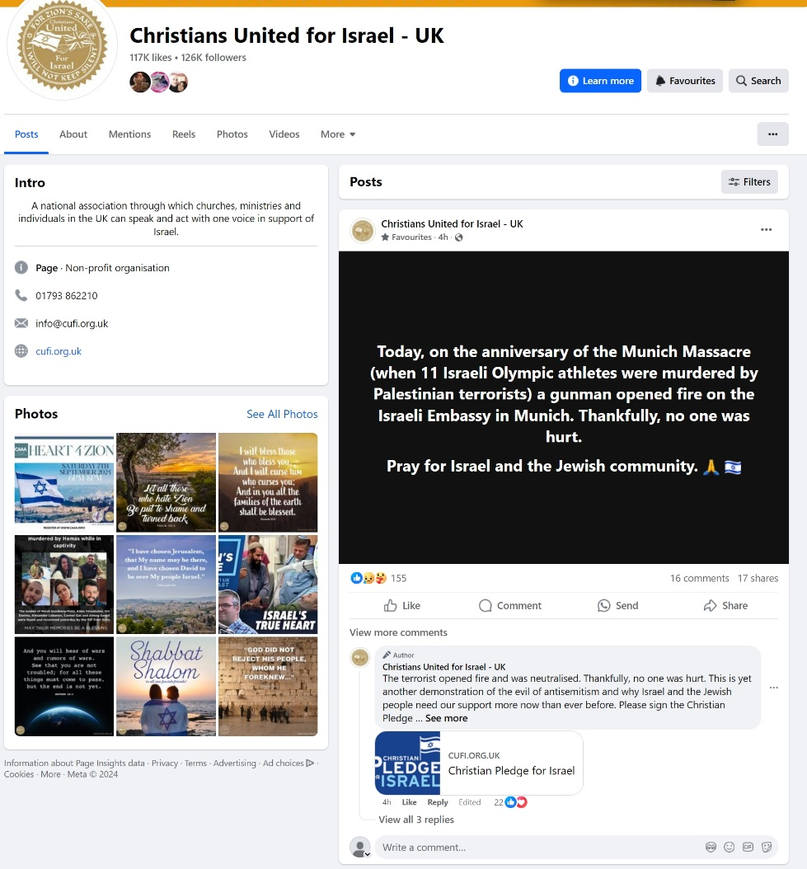
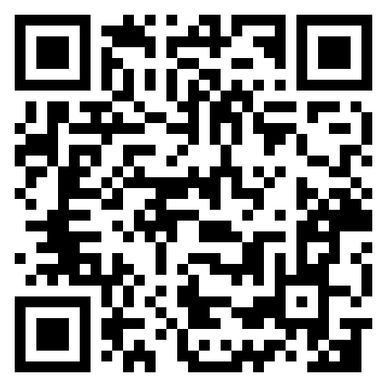

Communicating the Truth
www.cufi.org.uk
Facebook/christiansunitedforisraeluk

Slide 10


Slide 12
Why Christians should stand with Israel
Alastair Kirk
Christians United for Israel UK

Slide 13
1. God LOVES Israel

Slide 14
Psalm 87:2
The Lord loves the gates of Zion
More than all the dwellings of Jacob.
Psalm 132:13-14
For the Lord has chosen Zion;
He has desired it for His dwelling place:
“This is My resting place forever;
Here I will dwell, for I have desired it.”

Slide 15
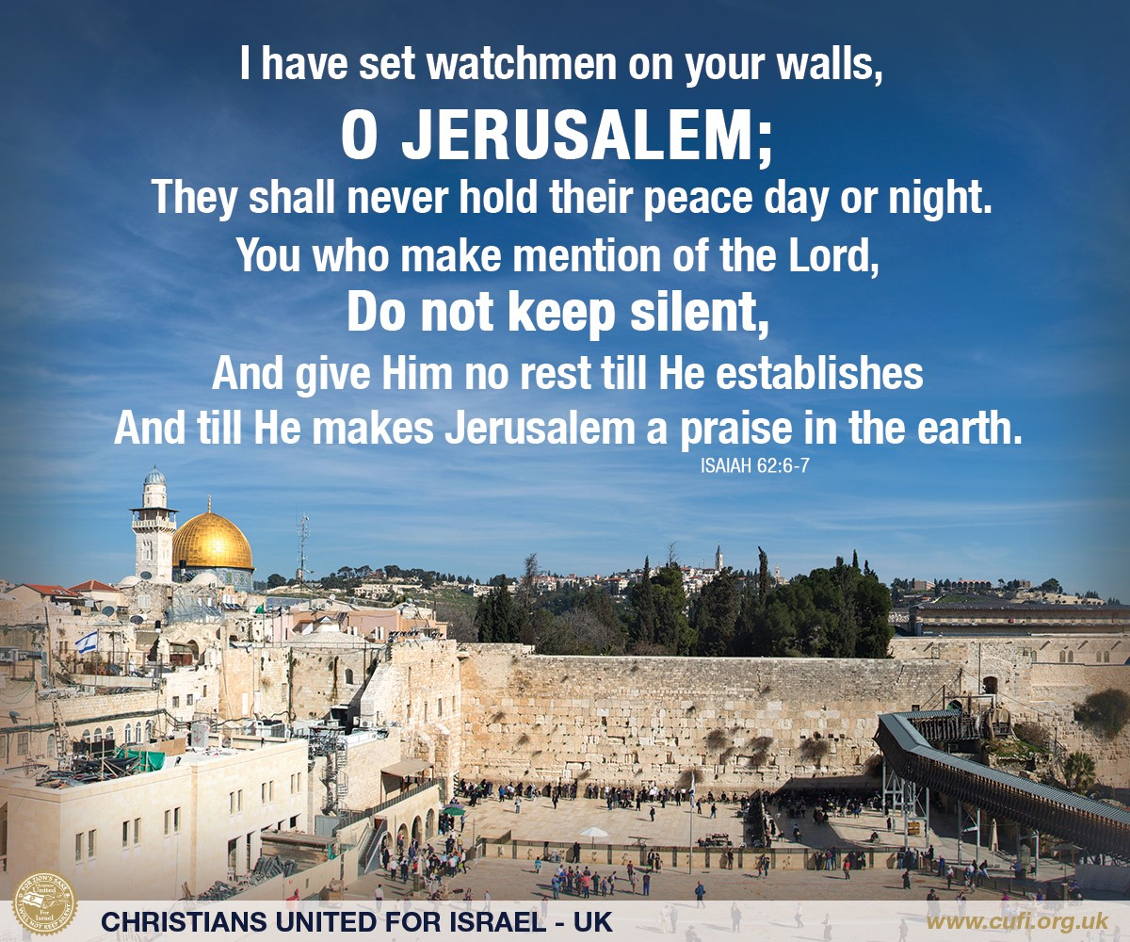

Slide 16
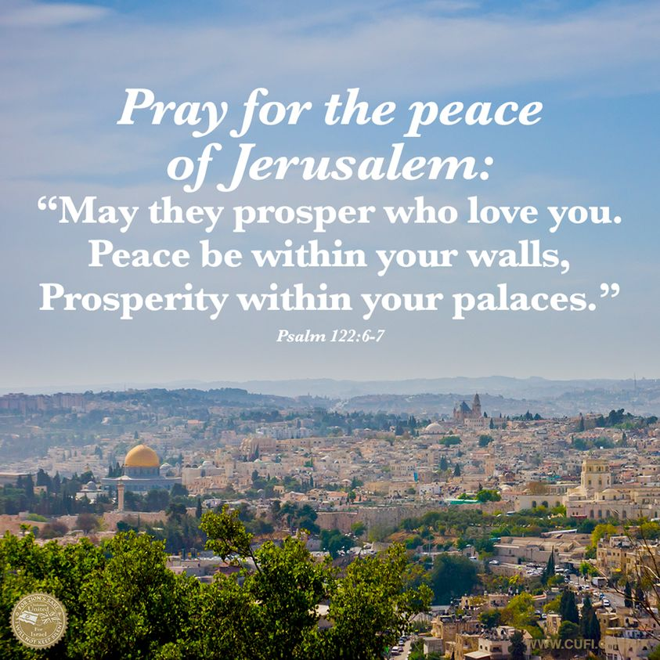

Slide 17
2. Christians are to BLESS Israel

Slide 18
Genesis 12:2-3
“I will make you a great nation;
I will bless you
And make your name great;
And you shall be a blessing.
I will bless those who bless you,
And I will curse him who curses you;
And in you all the families of the earth shall be blessed.”

Slide 19
3. Christians have a CONNECTION with the Jewish people

Slide 20
Romans 11:18
“do not boast against the branches. But if you do boast, remember that you do not support the root, but the root supports you.”

Slide 21
4. God has made a COVENANT with Israel

Slide 22
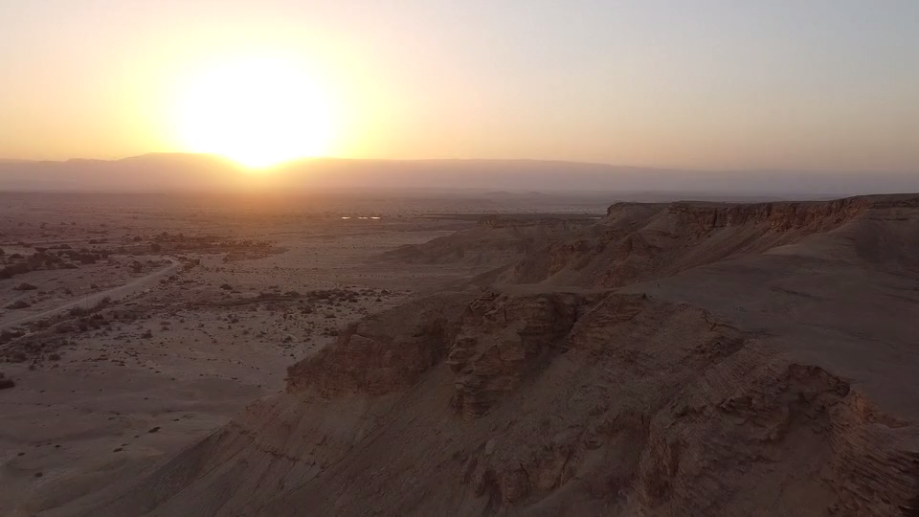
Genesis 17:6-8
“I will make you exceedingly fruitful; and I will make nations of you, and kings shall come from you. And I will establish My covenant between Me and you and your descendants after you in their generations, for an everlasting covenant, to be God to you and your descendants after you. Also I give to you and your descendants after you the land in which you are a stranger, all the land of Canaan, as an everlasting possession; and I will be their God.”

Slide 23
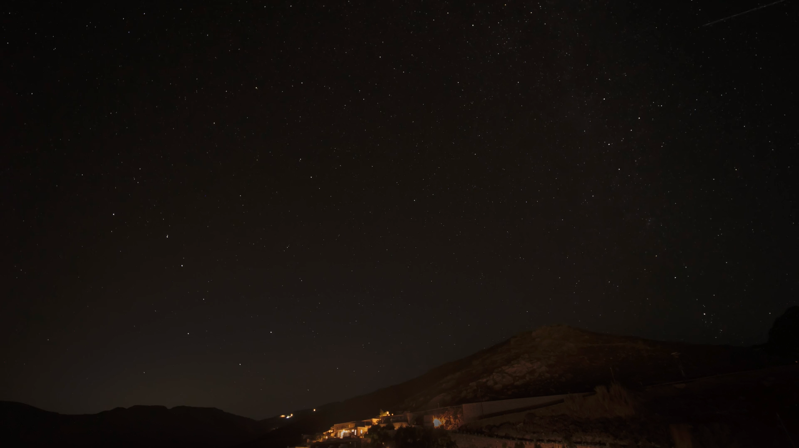
ABRAHAM - Genesis 22:15-18
“By Myself I have sworn, says the Lord, because you have done this thing, and have not withheld your son, your only son— blessing I will bless you, and multiplying I will multiply your descendants as the stars of the heaven and as the sand which is on the seashore; and your descendants shall possess the gate of their enemies. In your seed all the nations of the earth shall be blessed, because you have obeyed My voice.”

Slide 24
ISAAC -Genesis 26:3-5
“…for to you and your descendants I give all these lands, and I will perform the oath which I swore to Abraham your father…. because Abraham obeyed My voice and kept My charge, My commandments, My statutes, and My laws.”

Slide 25
JACOB – Genesis 28:13-14
And behold, the LORD stood above it and said: “I am the LORD God of Abraham your father and the God of Isaac; the land on which you lie I will give to you and your descendants. Also your descendants shall be as the dust of the earth; you shall spread abroad to the west and the east, to the north and the south; and in you and in your seed all the families of the earth shall be blessed.

Slide 26
EVERLASTING MEANS EVERLASTING

Slide 27
For when God made a promise to Abraham, because He could swear by no one greater, He swore by Himself, saying, “Surely blessing I will bless you, and multiplying I will multiply you.”
Hebrews 6:13-14

Slide 28
God has NOT forsaken His people
Psalm 94:14
“For the Lord will not cast off His people, nor will He forsake His inheritance.”
Romans 11:1-2
I say then, has God cast away His people? Certainly not! For I also am an Israelite, of the seed of Abraham, of the tribe of Benjamin. God has not cast away His people whom He foreknew.

Slide 29
THE LAND IS PART OF
ISRAEL’S INHERITANCE

Slide 30
Deuteronomy 32:9
For the Lord’s portion is His people;
Jacob is the place of His inheritance.

Slide 31
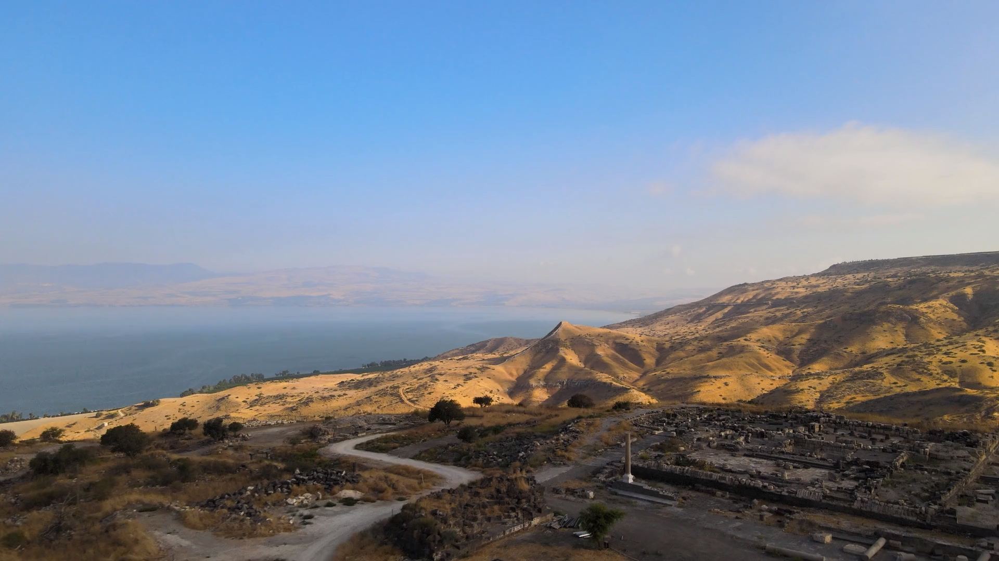
Deuteronomy 30:3-4
…that the Lord your God will bring you back from captivity, and have compassion on you, and gather you again from all the nations where the Lord your God has scattered you. If any of you are driven out to the farthest parts under heaven, from there the Lord your God will gather you, and from there He will bring you.

Slide 32
“I do not do this for your sake, O house of Israel, but for My holy name’s sake.”
Ezekiel 32:22

Slide 33
Amos 9:15
I will plant them in their land,
And no longer shall they be pulled up
From the land I have given them,”
Says the Lord your God.
Zechariah 2:12
And the Lord will take possession of Judah as His inheritance in the Holy Land, and will again choose Jerusalem.
Obadiah 1:17
“But on Mount Zion there shall be deliverance,
And there shall be holiness;
The house of Jacob shall possess their possessions.

Slide 34
5. Christians are to defend Israel

Slide 35
Zechariah 12:2-3
“Behold, I will make Jerusalem a cup of drunkenness to all the surrounding peoples, when they lay siege against Judah and Jerusalem. And it shall happen in that day that I will make Jerusalem a very heavy stone for all peoples; all who would heave it away will surely be cut in pieces, though all nations of the earth are gathered against it.”

Slide 36
Psalm 83:3-5
They have taken crafty counsel against Your people,
And consulted together against Your sheltered ones.
They have said,
“Come, and let us cut them off from being a nation,
That the name of Israel may be remembered no more.”
For they have consulted together with one consent;
They form a confederacy against You:

Slide 38
Responding to the rise in antisemitism
Alastair Kirk

Slide 39
The Burden

Slide 40
The Stages of Antisemitism

Slide 41
But it so happened, when Sanballat heard that we were rebuilding the wall, that he was furious and very indignant, and mocked the Jews. And he spoke before his brethren and the army of Samaria, and said, “What are these feeble Jews doing?
Trends of antisemitism
PHASE 1 – Words
| Nehemiah 4:1-2a

Slide 42
But it so happened, when Sanballat heard that we were rebuilding the wall, that he was furious and very indignant, and mocked the Jews. And he spoke before his brethren and the army of Samaria, and said, “What are these feeble Jews doing?
Trends of antisemitism
PHASE 1 – Words
| Nehemiah 4:1-2a

Slide 43
When Sanballat the Horonite and Tobiah the Ammonite official heard of it, they were deeply disturbed that a man had come to seek the well-being of the children of Israel.
Trends of antisemitism
PHASE 1 – Words
| Nehemiah 2:10

Slide 44
But it so happened, when Sanballat heard that we were rebuilding the wall, that he was furious and very indignant, and mocked the Jews. And he spoke before his brethren and the army of Samaria, and said, “What are these feeble Jews doing?
Trends of antisemitism
PHASE 1 – Words
| Nehemiah 4:1-2a

Slide 45
Now it happened, when Sanballat, Tobiah, the Arabs, the Ammonites, and the Ashdodites heard that the walls of Jerusalem were being restored and the gaps were beginning to be closed, that they became very angry, and all of them conspired together to come and attack Jerusalem and create confusion.
Trends of antisemitism
PHASE 2 – Confusion
| Nehemiah 4:7-8

Slide 46
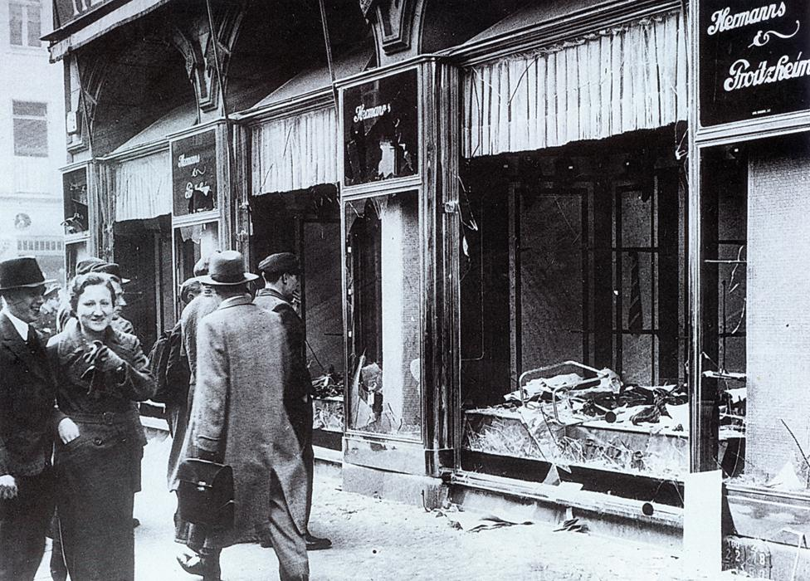

Slide 47
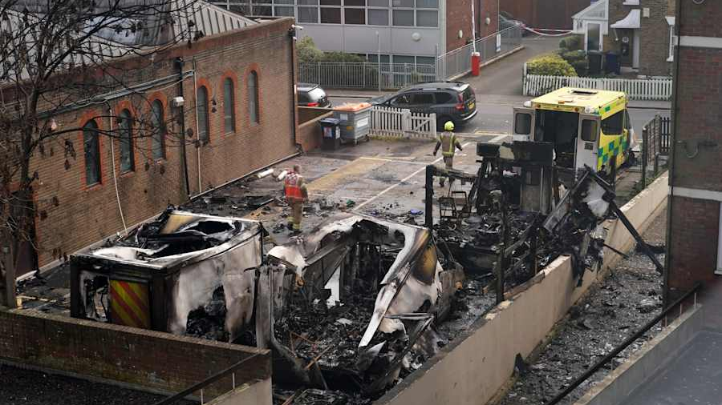

Slide 48
And our adversaries said, “They will neither know nor see anything, till we come into their midst and kill them and cause the work to cease.”
Trends of antisemitism
PHASE 3 – Violence
| Nehemiah 4:11

Slide 49
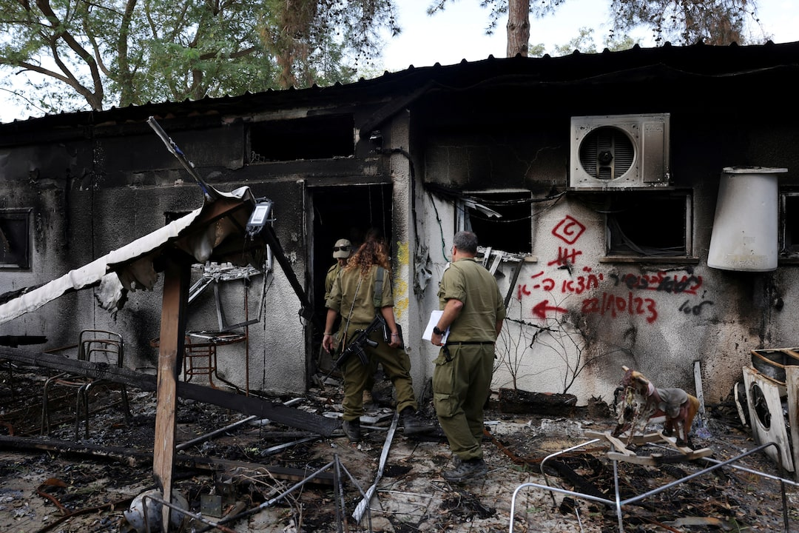
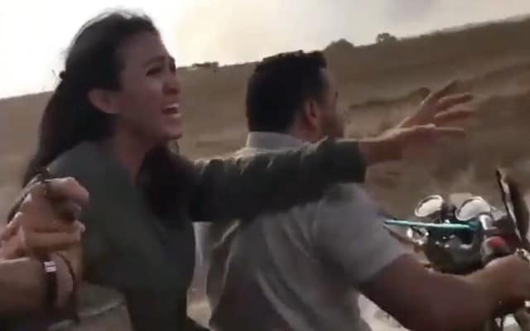
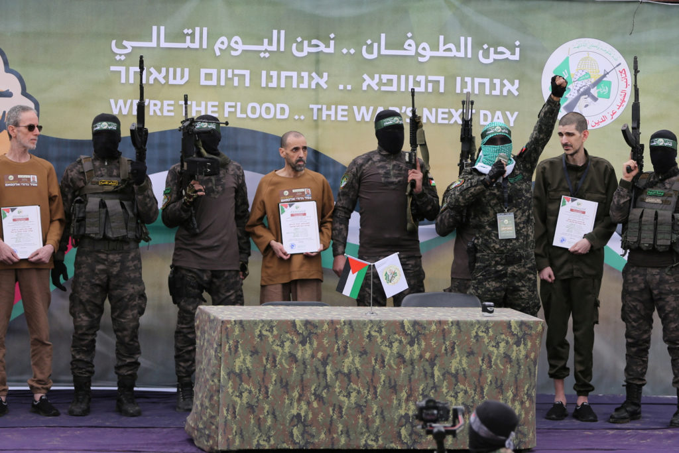
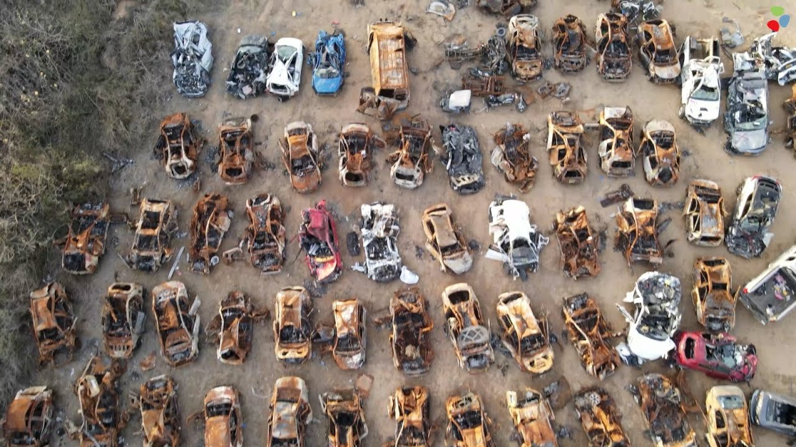

Slide 50
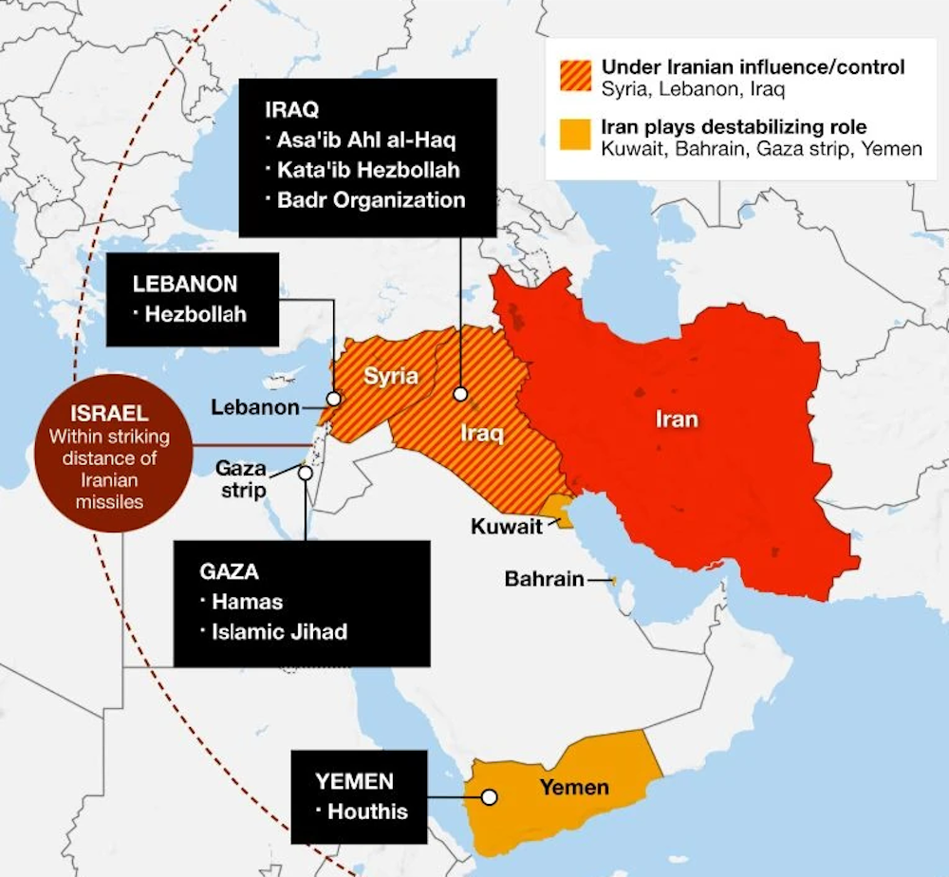
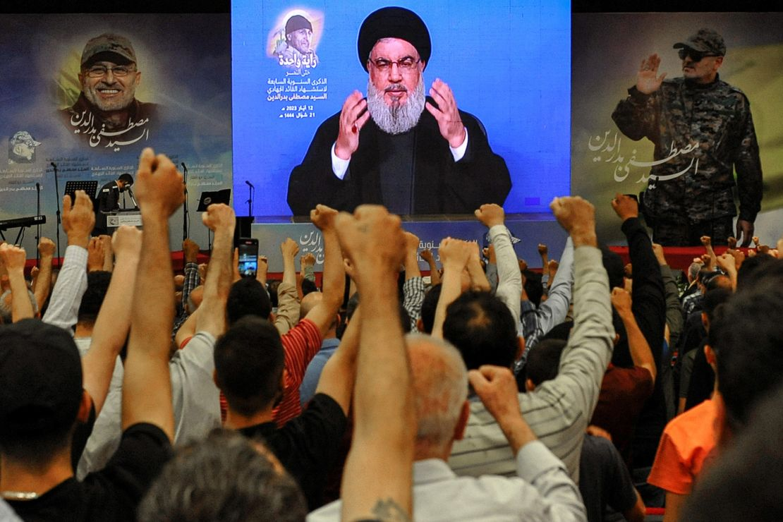
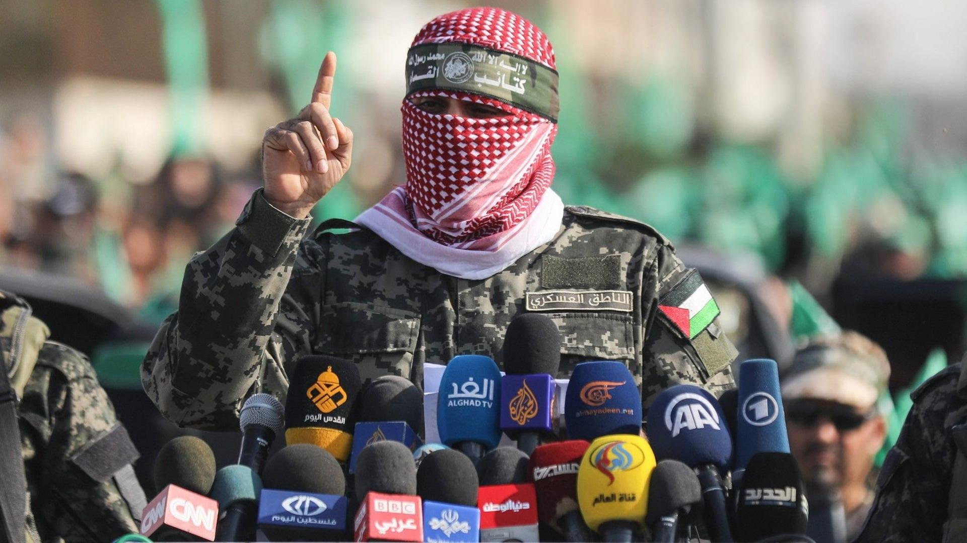
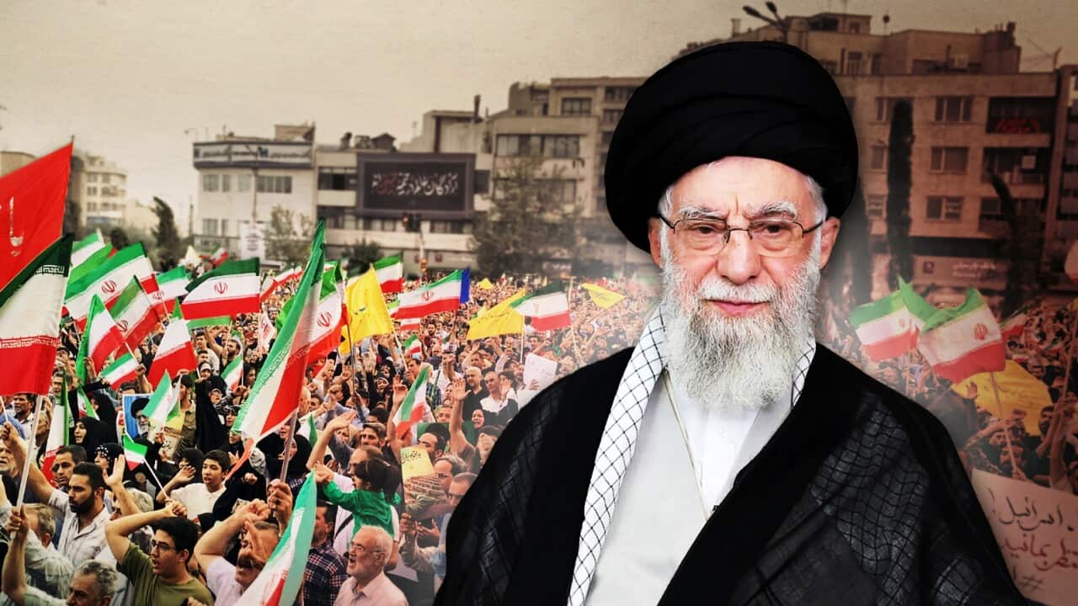

Slide 51


Slide 52
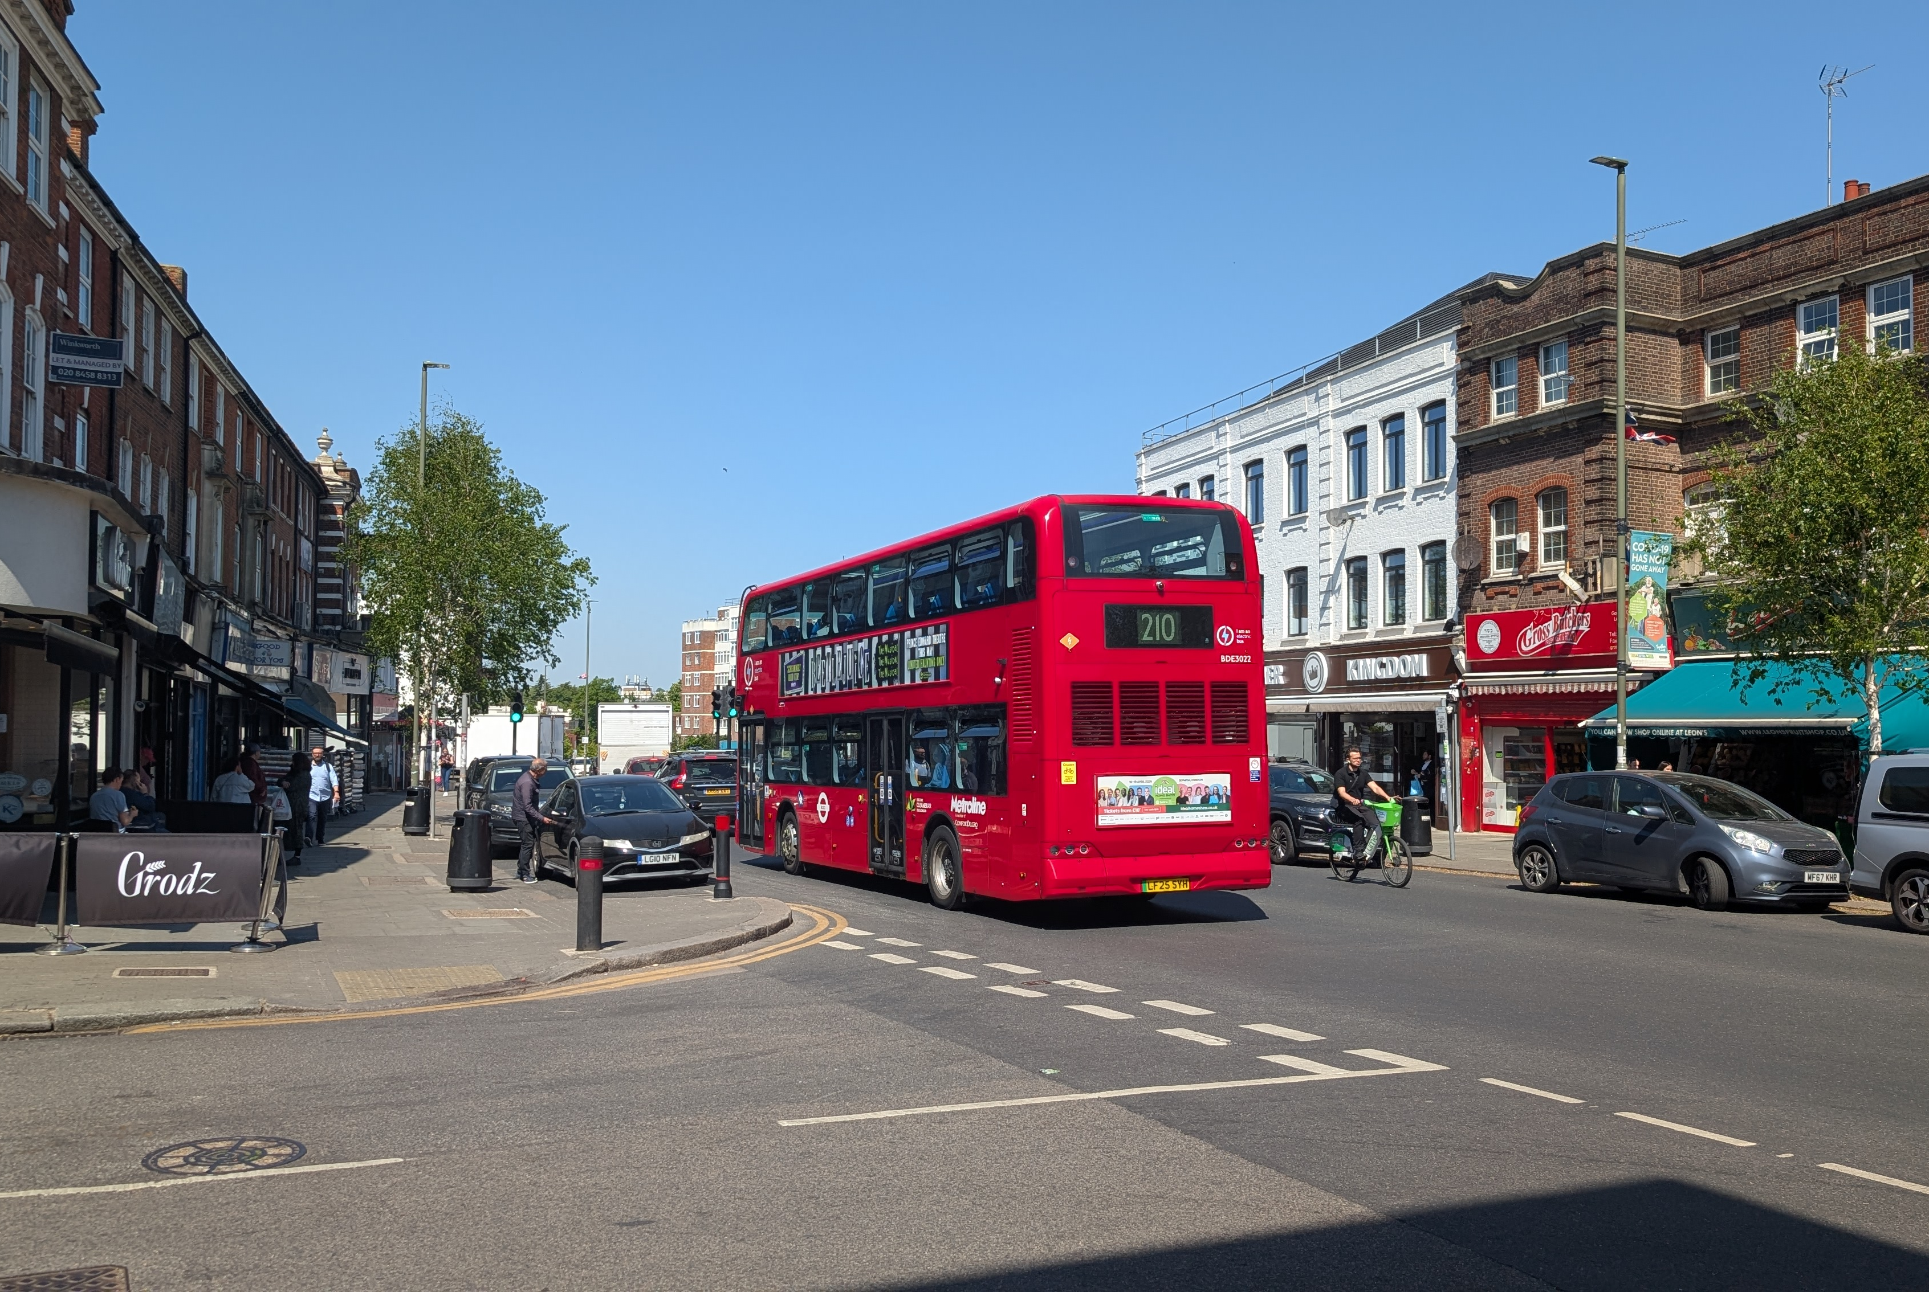
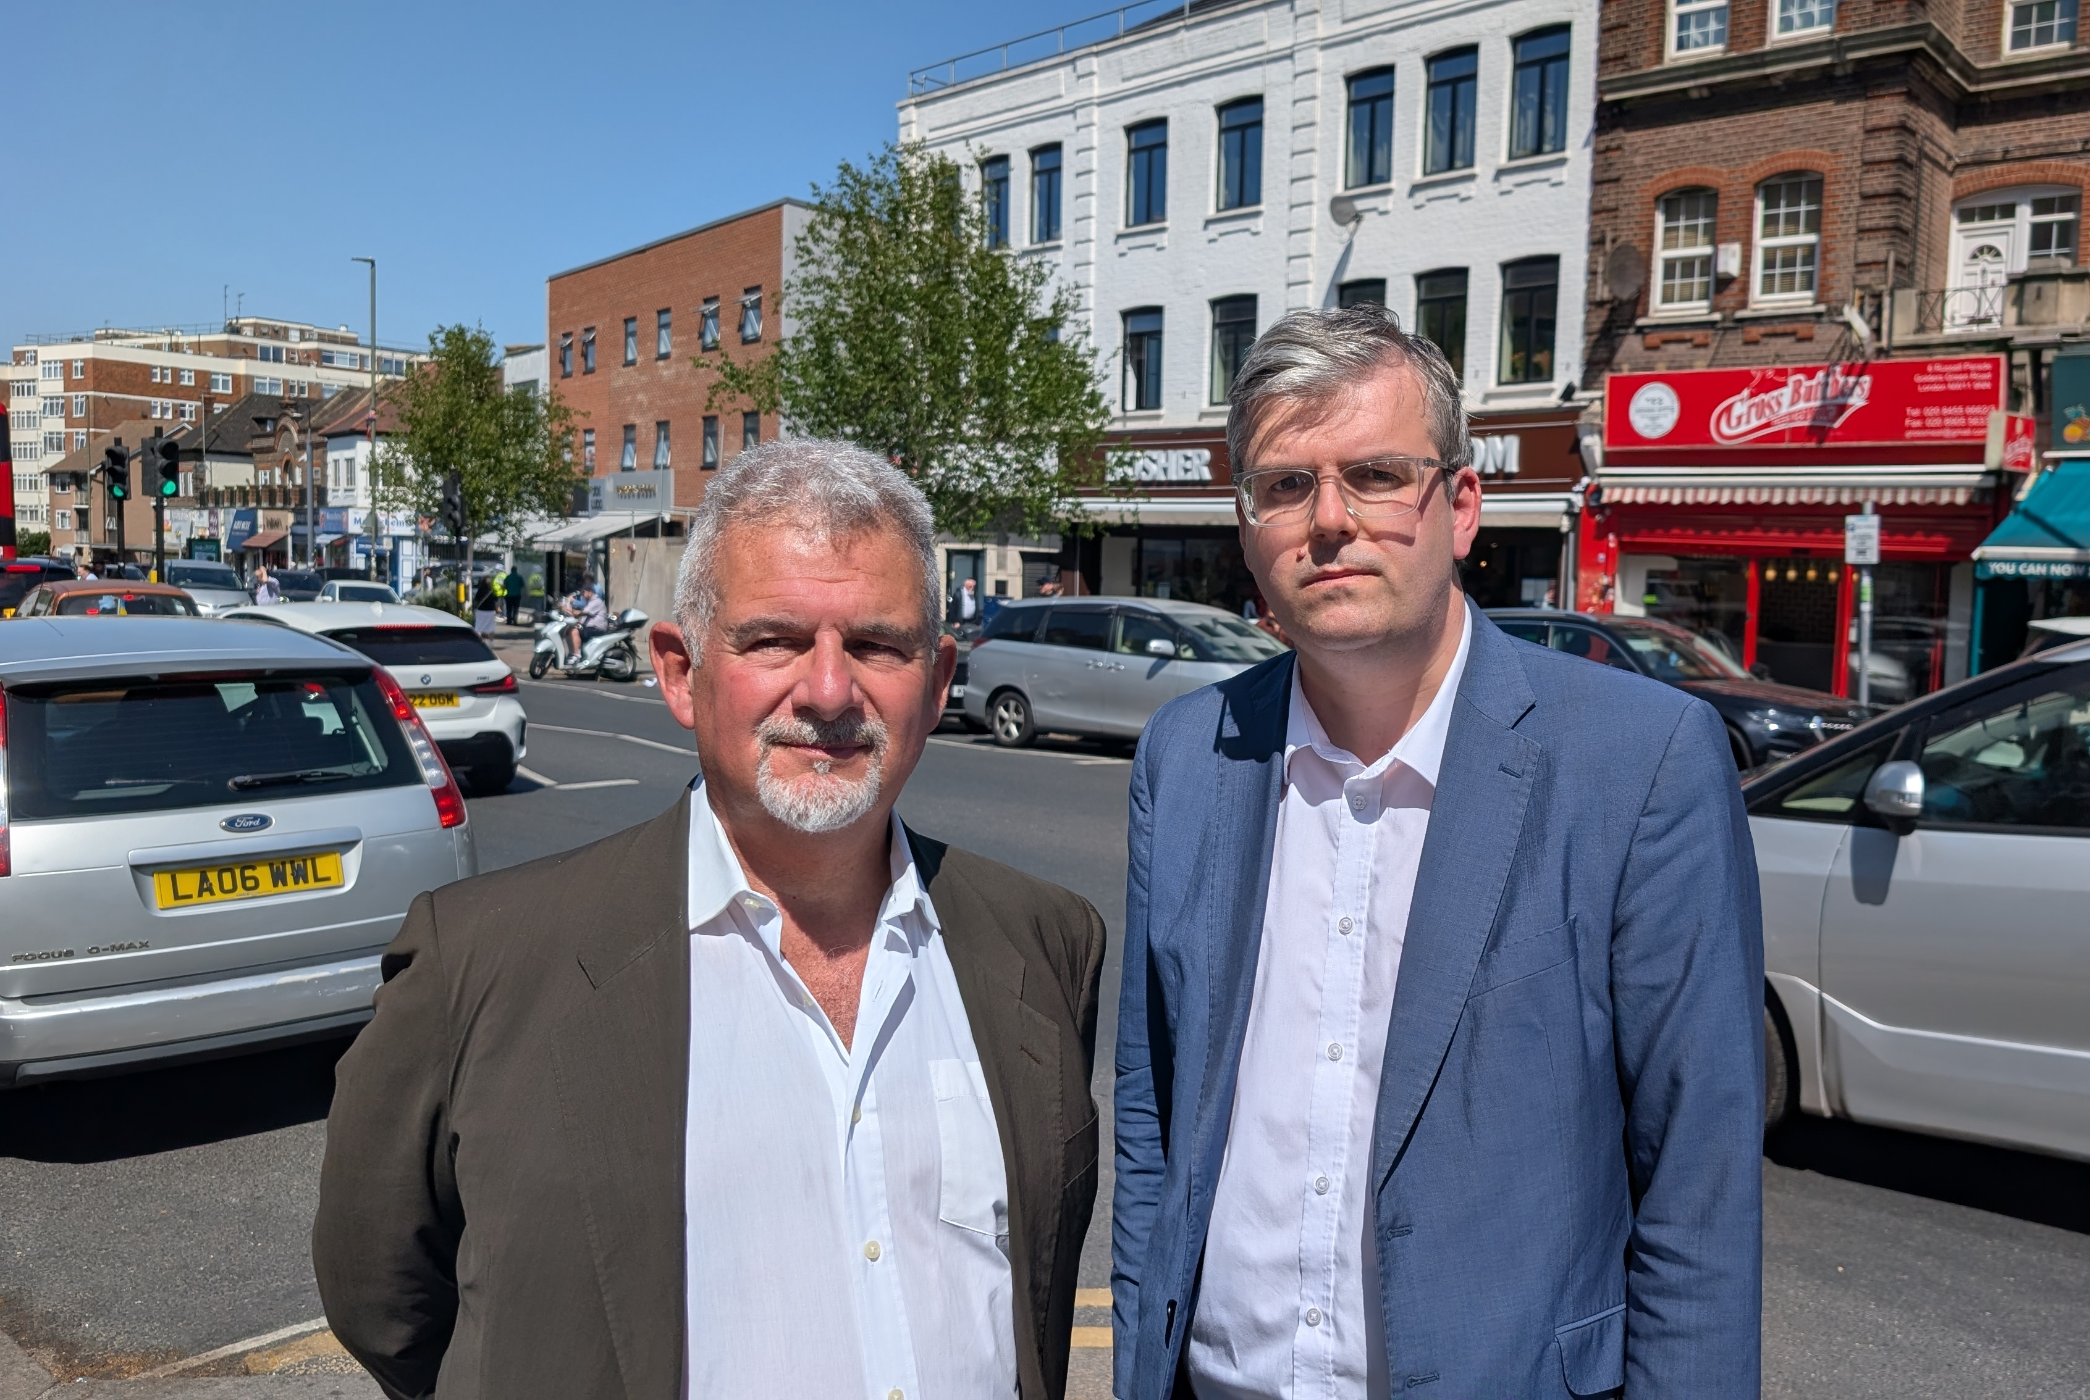

Slide 53
Words
Confusion
Violence

Slide 54
“Delegitimise”
“Israel is occupying the Land!”
“Demonise”
“Israel is evil and to be blamed!”
“Destroy”
“Israel has no right to exist”

Slide 55
Never again is now

