Slide 1
Take my yoke upon you

Slide 2
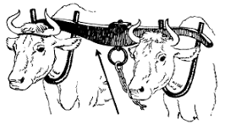

Slide 3
Matthew 11:28-30 (The Living Bible)
Come to me and I will give you rest—all of you who work so hard beneath a heavy yoke. Wear my yoke—for it fits perfectly—and let me teach you; for I am gentle and humble, and you shall find rest for your souls; for I give you only light burdens.”

Slide 4
God’s peace is beyond understanding and will keep your hearts and minds at one with Christ Jesus (Colossians 3:15 the Truth)

Slide 5
In all your ways acknowledge him and he shall direct your paths (Proverbs 3:6 (ASV))
Let the peace of Christ be a guiding principle in your life (Colossians 3:15 The Truth)

Slide 6
John 14:15-17 (NLT)
“If you love me, obey my commandments. And I will ask the Father, and he will give you another Advocate, who will never leave you. He is the Holy Spirit, who leads into all truth.

Slide 7
The Lord helps the fallen and lifts those bent beneath their loads. (Psalm 145:14 NLT)
For when we suffer in our own bodies, we share in Jesus’ own passion and death, so that His risen life may also be revealed through our bodies (2 Corinthians 4:10 The Truth)

